Slide 1
Robot Cognition
Team Toucan
Final Presentation
Sponsor: Bill Michael
Faculty Sponsor: Leslie Tekamp
12-9-2022

Slide 2
Contents
Problem Specification
Requirements
Design Overview
Testing and Analysis
Project Status
Software Integration

Slide 3
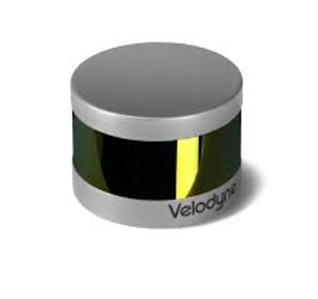
Problem Description
The goal of this project is to create a platform that can incorporate sensors to allow for the mapping of its surrounding area.
Sensors that will be used are:
GPS
Inertial Measurement Unit (IMU)
LiDAR
Camera
The platform must weigh less than 5kg
Formats data into a single processing system

Slide 4
Customer Requirements
Requirement
Power Supply | 18-48V
Peripherals | GPS, IMU, LIDAR, Camera
Power Output | 5VDC at 10A
Power Output | 3.3VDC at 10A
Power Output | 12VDC at 5A
Generates | Point-cloud data, spatial and image data, location data
Collects | Accurate geo positioning, image and video collection, attitude and gyroscope data, inertial data

Slide 5
Standards
Standard | Explanation
IEEE 802 | Ethernet speeds of operation from 1 Mb/s to 400 Gb/s using a common media access control (MAC)
MIPI A-PHY | Asymmetric data link layer with point-to-point or daisy-chain topology used in camera interface
EN55032​ | Emission standard for electronic devices to keep their electromagnetic output from interfering with other devices

Slide 6
Major Hardware
Processor: NVIDIA Jetson Nano
Integrate the following onto one platform:
Xsens MTI-10-2A8G4 (Inertial measurement unit)
Ublox LEA-M8T with WD22UGRC interface board (Global positioning system)
Velodyne LiDAR PUCK 16 (LIDAR)
IMX219-160 (Camera)
18-36V LIPO battery

Slide 7
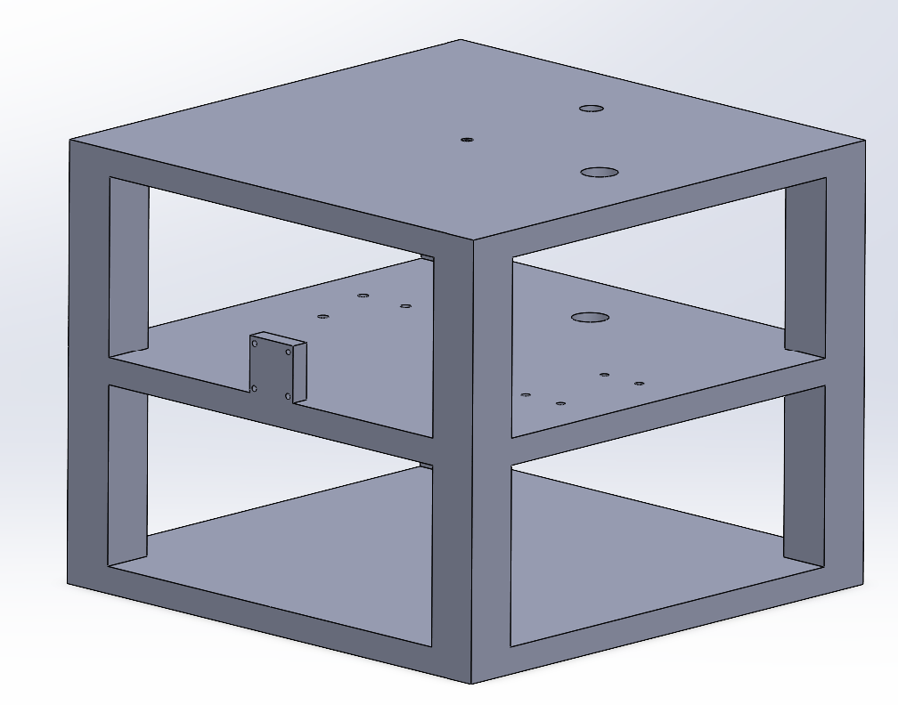
Design Overview

Slide 8
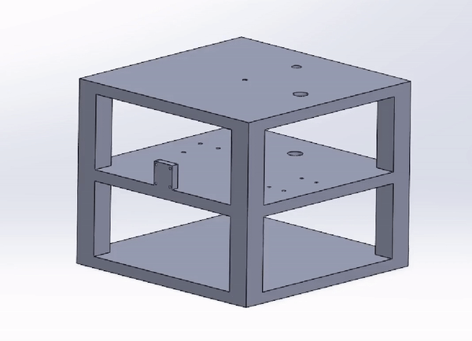
3D Model cont.

Slide 9
Component Weights
Total weight of platform: 2971 g
2029 g extra for any needed additions
Total Component Weight
Item | Weight (g)
LIDAR | 849
GPS + Antenna | 97
NANO | 269
Camera | 37
Cased IMU | 56
Total | 1308

Slide 10
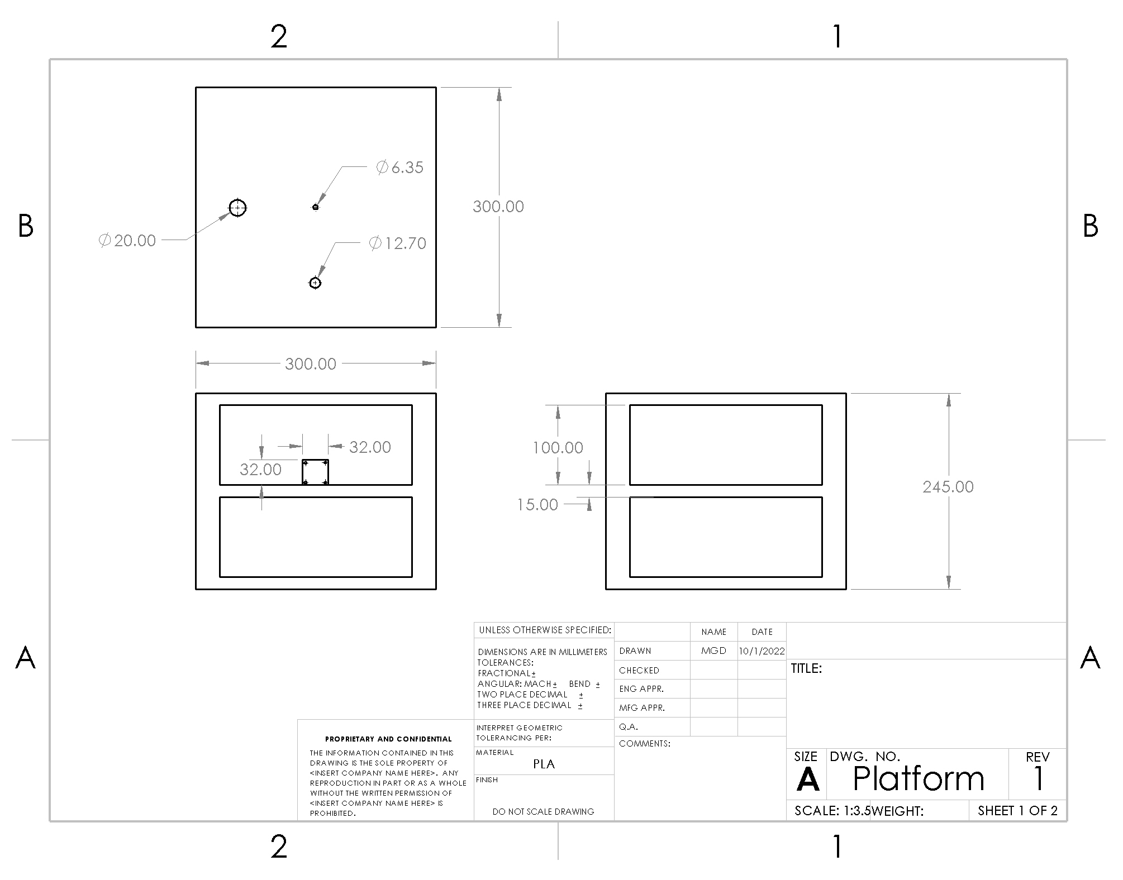
Design Drawings

Slide 11
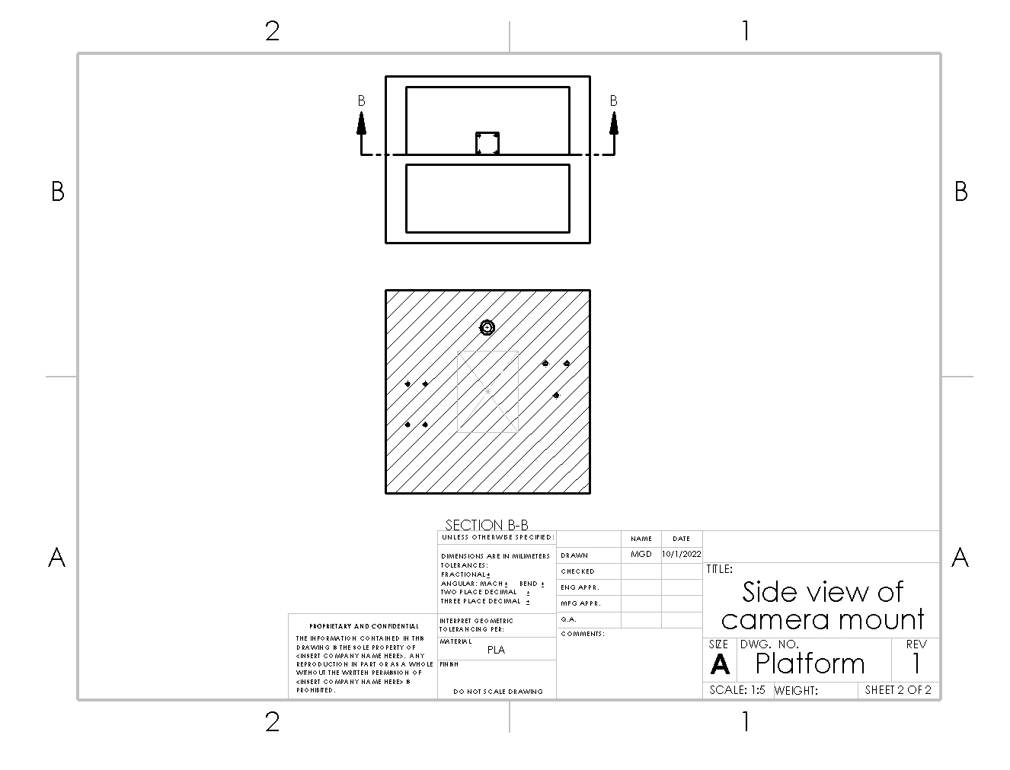
Design Drawings cont.

Slide 12
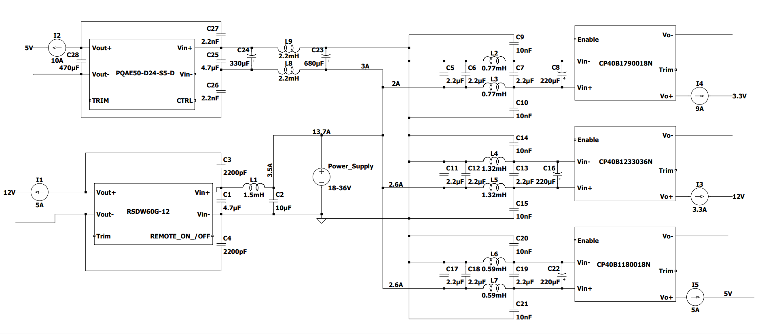
Electrical Connections Design

Slide 13
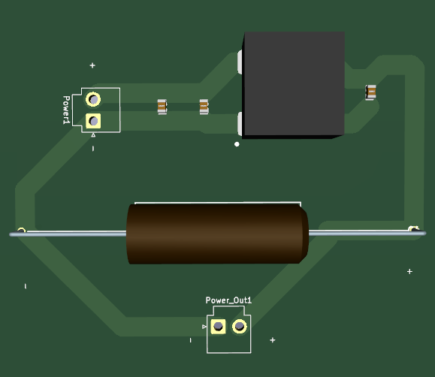
PCB for External Components
PCB Designed to be built through OSH Park
Large Tracks to account for high current requirements

Slide 14
Power Connections
Point A | Point B | # of Connection | Connector
Battery | Wire A (6 AWG) | 2 | EC5
Wire A | CP40B Externals | 6 | Soldered 14 AWG Wire
Wire A | PQAE50 Externals | 2 | Soldered 14 AWG Wire
Wire A | RSDW60G Externals | 2 | Soldered 14 AWG Wire
CP40B Externals | CP40B DC/DC | 6 | Wire Pin Terminal
PQAE50 Externals | PQAE50 DC/DC | 4 | Wire Pin Terminal
RSDW60G Externals | RSDW60G DC/DC | 4 | Wire Pin Terminal
CP40B DC/DC (5V) | Jetson Nano | 2 | Wire Pin Terminal
CP40B DC/DC (12V) | LIDAR | 2 | Soldered 14 AWG Wire
CP40B DC/DC (3.3V) | Port A | 2 | Female to Male Pin Connector
PQAE50 DC/DC (5V) | Port B | 2 | Female to Male Pin Connector
RSDW60G DC/DC (12V) | Port C | 2 | Female to Male Pin Connector

Slide 15
Signal Connections
Point A | Point B | # of Connections | Connector
Jetson Nano | LIDAR | 1 | Ethernet
Jetson Nano | LEA-M8T (GPS) | 3 | UART
Jetson Nano | Xsens MTI-10-2A8G4 (IMU) | 1 | USB
Jetson Nano | e-CAM24_CUNX​ (Camera) | 1 | MIPI CSI-2
LEA-M8T | Antenna | 1 | SMB to TNC Coax

Slide 16
Testing and Analysis
Camera
Retrieved and displayed accurate imagery
GPS
Tested inside
Accurate time info
Less Accurate Locational Data
Independently tested power supply to sensors
Jetson Nano
LiDAR
Extra Port

Slide 17
Testing and Analysis Needs
End to End power testing
Battery
High Amperage
LiDAR
Receiving accurate point cloud data
IMU
Velocity and rotational testing

Slide 18
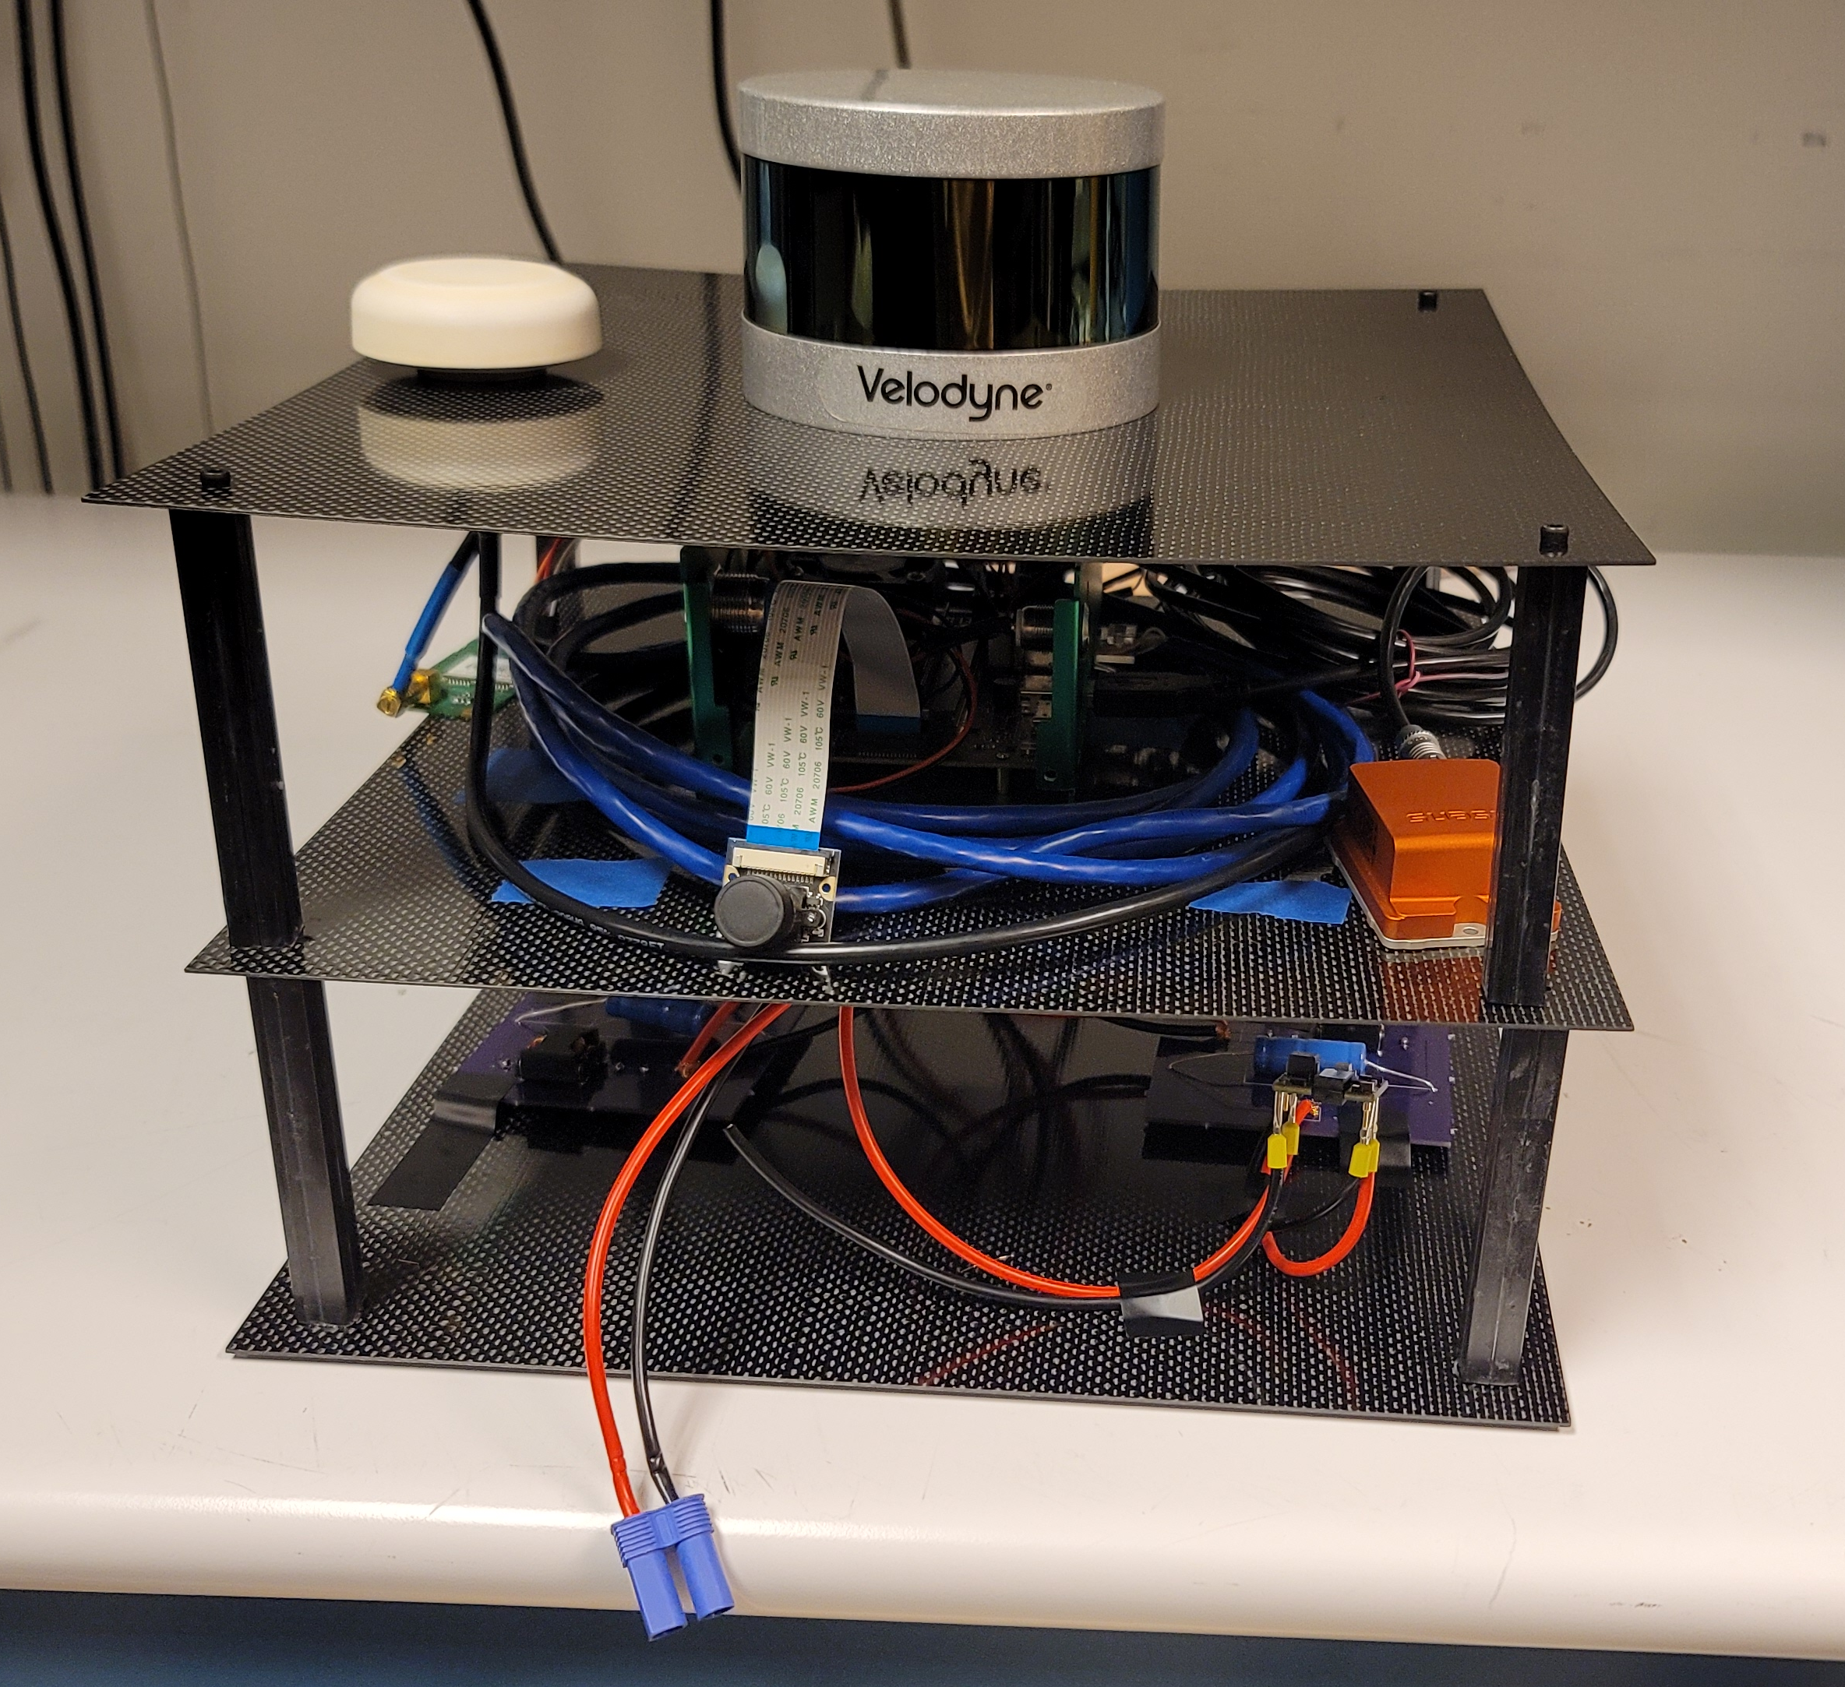
Project Status
Camera
Object Detection
GPS
Built Platform
All connections finalized

Slide 19
SDP: Installation of required Software and interfaces
Installation of runtime libraries
Installation of c++, python libraries
Interfaces for python,C++ to interface with TensorRT on the jetson nano
Installation of All I/O Drivers for the I/O components

Slide 20
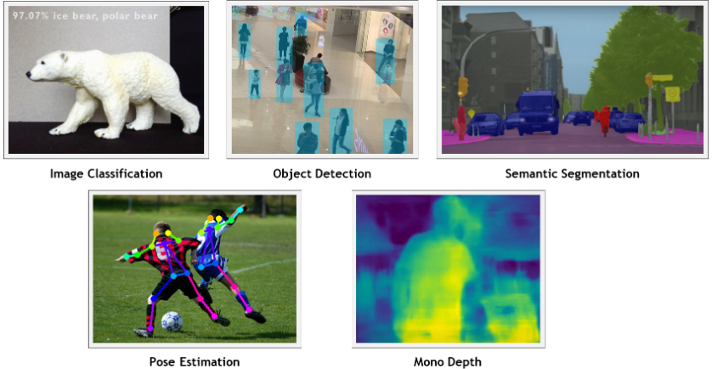
Software Integration - Camera
Connection type: MIPI Camera Serial Interface, Resolution: 720p (Max:1080p)
Programs: Jetson Nano Inference interface: Serves as a wrapper for Nvidia Tensor RT.
Neural Network: SSD-Mobilenet-v2
Algorithm: Single Shot Detection which runs a convolutional network on input image only one time and computes a feature map

Slide 21
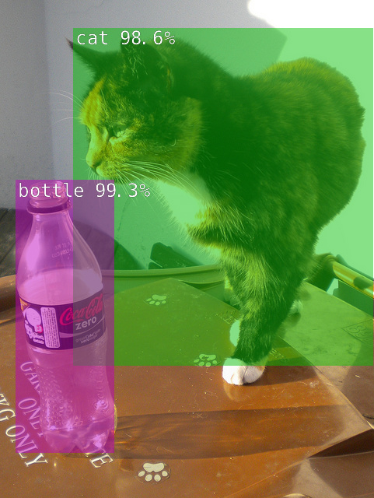
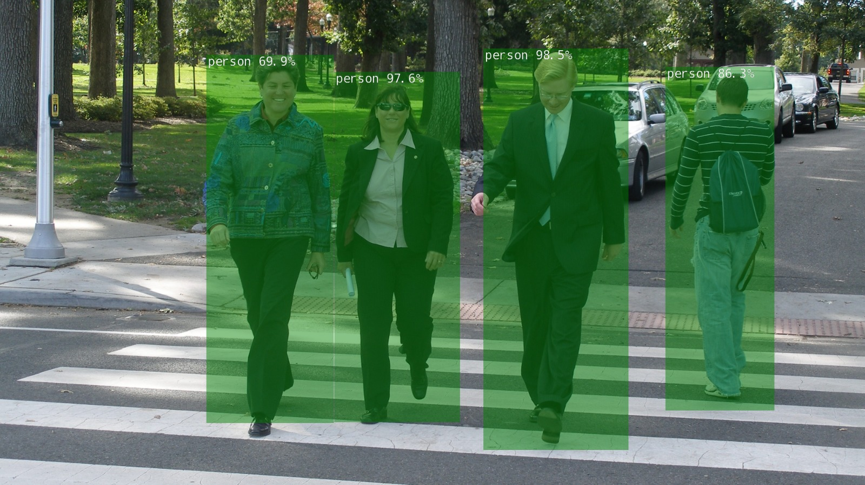
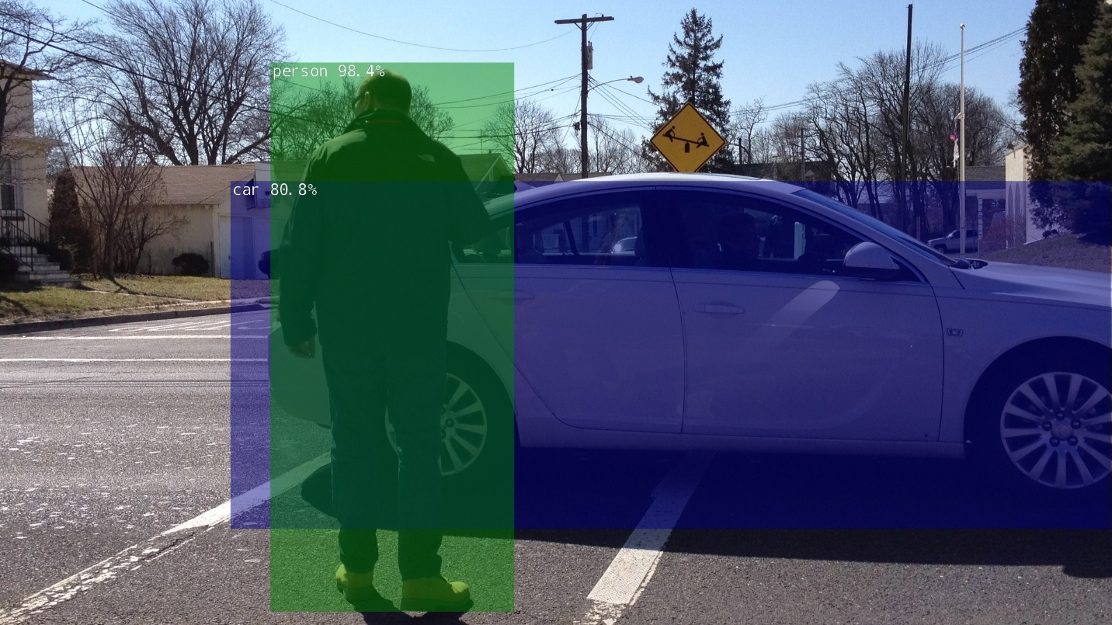
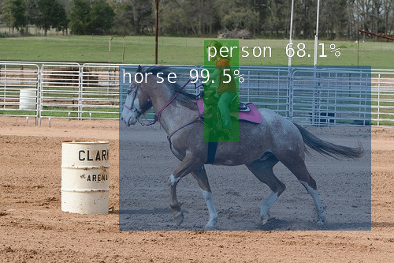
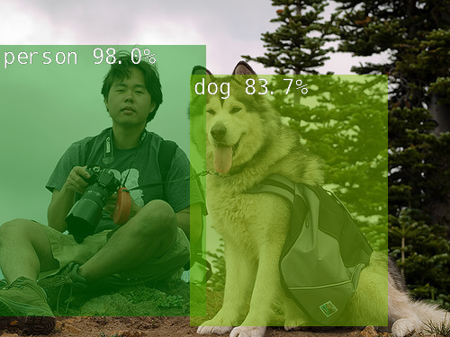
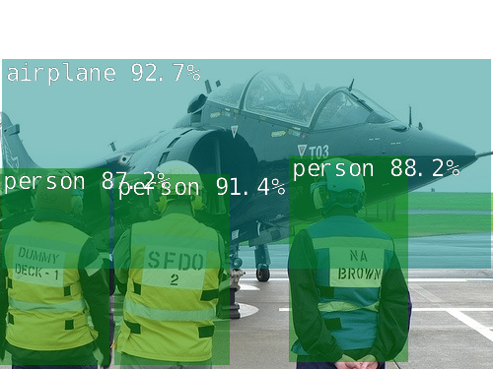
Software Integration – Camera (Cont'd)
Processed Images (SSD):

Slide 22
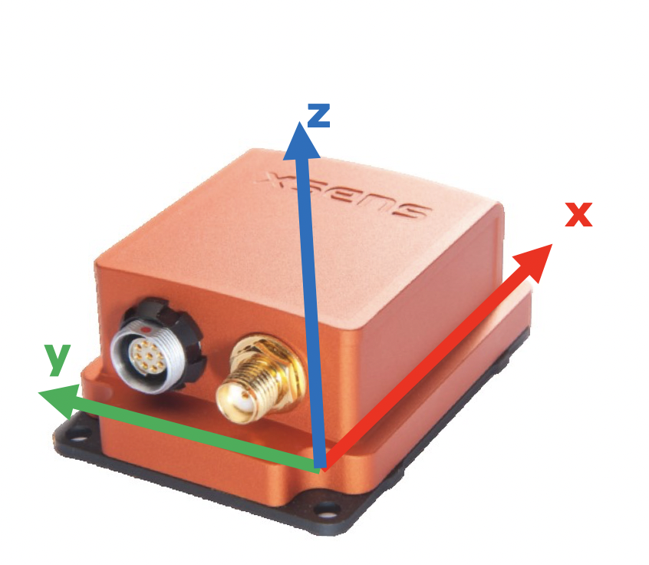
Software Integration - IMU
Software provided by Xsens
USB connection to NVIDIA
Issues:
Received incorrect data (registered the device as upside-down or at an angle when on a level surface)
Device is recognized by the computer, but not assigned a device number to receive input from

Slide 23
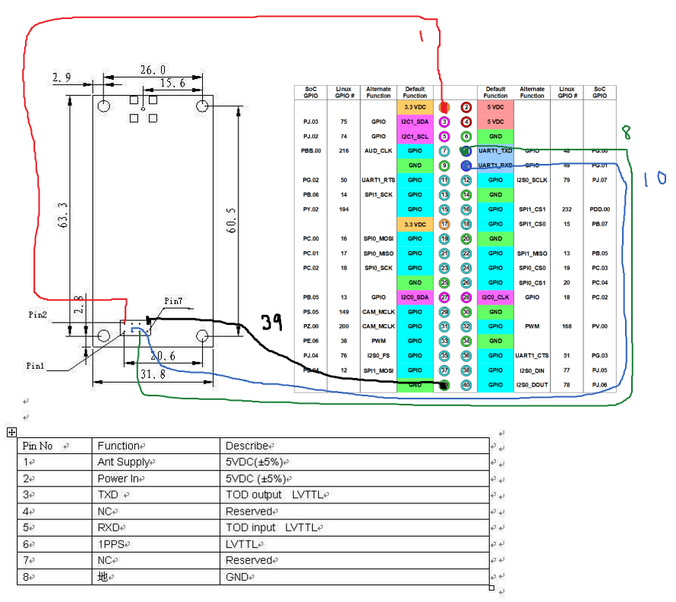
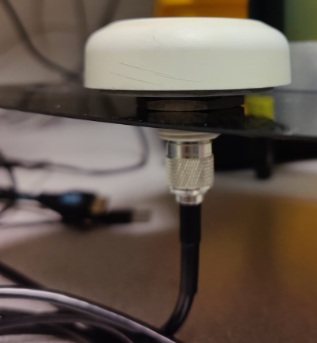
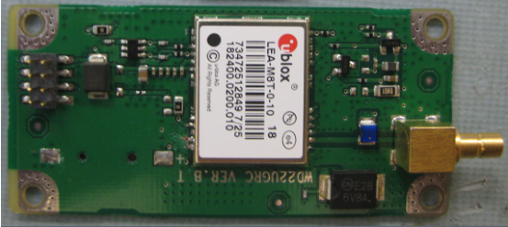
Software – Integration GPS
Ublox NEO/LEA-M8T
Vcc: 3.3v
Connection type: UART
Communcation Protocol: GPS NMEA
GPS Signal: GNSS
Accuracy: global average user range rate error <20 ns (1PPS)
Software: gpsd socket (IP), gpsmon (RL packet monitor)

Slide 24
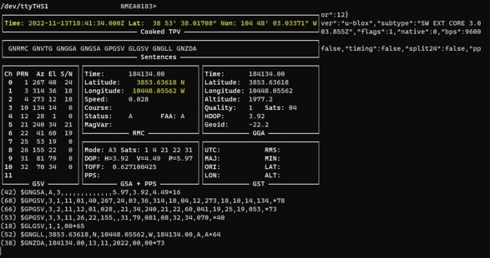
Software – Integration GPS (Cont'd)
Provided information through the packet monitor application:

Slide 25
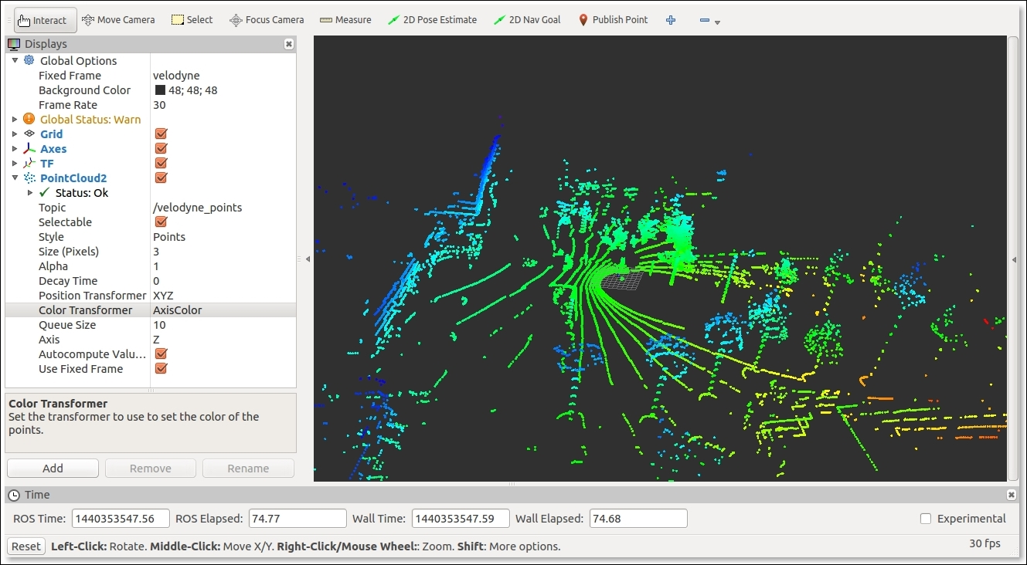
Software Integration - LiDAR
ROS RViz 3D visualization software
Point Cloud
Raw data
360° horizontal FOV
±15° vertical FOV

Slide 26
Bill of Materials
Item | Unit | Quantity | Total | Manufacturer | Description
IMX219-160 | $21.99 | 1 | $21.99 | Waveshare | Camera
NVIDIA Jetson Nano | $259.00 | 1 | $259.00 | NVIDIA | processing unit
Velodyne LIDAR PUCK 16 | $4,000.00 | 1 | $4,000.00 | Velodyne LIDAR | LIDAR
MTI-10-2A8G4 | $759.00 | 1 | $759.00 | Xsens | IMU
LEA-M8T | $89.00 | 1 | $89.00 | Ublox | GPS
Carbon Fiber Platform |  | 1
HDMI Cable |  | 1
CP40B_1790018 | $26.47 | 1 | $26.47 | Semiconductor Circuits Inc | DC/DC converter
CP40B_1180018 | $26.47 | 1 | $26.47 | Semiconductor Circuits Inc | DC/DC converter
CP40B_1233036 | $28.60 | 1 | $28.60 | Semiconductor Circuits Inc | DC/DC converter
PQAE50-D24-S5-D | $37.57 | 1 | $37.57 | CUI Inc | DC/DC converter
RSDW60G-12 | $63.77 | 1 | $63.77 | Mean Well | DC/DC converter
CA-USB-MTI | $68.00 | 1 | $68.00 | Xsens | IMU Connector
PCB Boards | $20.00 | 6 | $120.00 | OSH Park | PCB for external power components
Misc Wires | $30.00 | 1 | $30.00 |  | Wire for PCB connection to sensors
Total |  |  | $5,529.87

Slide 27
Thank You!
Any Questions?

Slide 28
Software Design Plan Introduction
Installation of required Software and interfaces
Building Code and testbenches for interfacing with the I/O components Through their drivers
Learning how to use the TensorRT interfaced through python/C++ for image recognition
Building Code for the robot to perform all customer requirements
Further testing for bugs, quality control of software.
Schedule and deadlines

Slide 29
SDP: Learning how to use the TensorRT interfaced through python/C++ for image recognition
Learning the libraries for python and C++
Writing the first program to run the inference of an image through TensorRT
Testing the percentages of accuracy for different detected objects, ensuring Hardware/Software cohesion
Testing different images with the recognition on the jetson nano with pre trained networks
Building a custom network for the specified customer requirements if needed

Slide 30
Building Code for the robot to perform all customer requirements
Code to Deal with Datapaths (all inputs from I/O Components such as Lidar and Camera)
Code for the controller for navigation, states, and decision making.
Testing in various environments

Slide 31
Test Plan Introduction
Testing is required to ensure that all the individual components are working properly in addition the components all working together properly
Tests ensure that the:
GPS captures accurate positioning data at all locations
IMU captures correct inertial and velocity in all instances
LIDAR and camera captures correct imaging data in any space

Slide 32
Test Plan Methodology and Procedure: GPS
Upon integration, the GPS will be taken to several locations to read coordinates
The coordinates read from the GPS will be compared to coordinates found on Google Maps.
A successful result will yield GPS coordinates within 10 meters of the actual location
An unsuccessful result will yield GPS coordinates that are more than 10 meters away from the actual location

Slide 33
Test Plan Methodology and Procedure: IMU
Upon integration, the IMU will be turned in different ways (ex. Upside down, a 30° angle, 175° angle), taken to different altitudes (ex. Colorado Springs, Denver, Pikes Peak), and moved at different speeds (driven in a car)
Captured data will be analyzed
A successful result will show correct measurement for all attitudes, altitudes, and velocity
An unsuccessful result will be if the measurements do not match the expected values

Slide 34
Test Plan and Methodology: LIDAR and Camera
Upon integration, the LIDAR and camera will be taken to different environments (ex. Classroom, open field, parking lot) to capture imaging data
A successful result of the tests will show the LIDAR and camera accurately imaging each space
An unsuccessful result of the tests will show the LIDAR and camera inaccurately imaging each space

Slide 35
Test Plan Results and Analysis: GPS
Collected data: Coordinate data
Data was chosen because the purpose of the GPS is to provide positional data in the form of longitude and latitude coordinates
The collected data will be compared to data from Google Maps to ensure correctness

Slide 36
Test Plan Results and Analysis: IMU
Collected data: attitude (angle), distance from sea level (meters), and velocity (meters per second)
Data was chosen so that each capability of the IMU can be verified
This data will be compared to manually collected data from Google Maps or attitude readers to ensure correctness

Slide 37
Test Plan Results and Analysis: LIDAR and Camera
Collected data: Visual Imaging
Data was chosen because the purpose of the LIDAR and camera is to provide visuals
The collected data will be compared to team members’ observations of the space to ensure correctness

